Slide 1
Getting Started in Zoom with Android

Slide 2
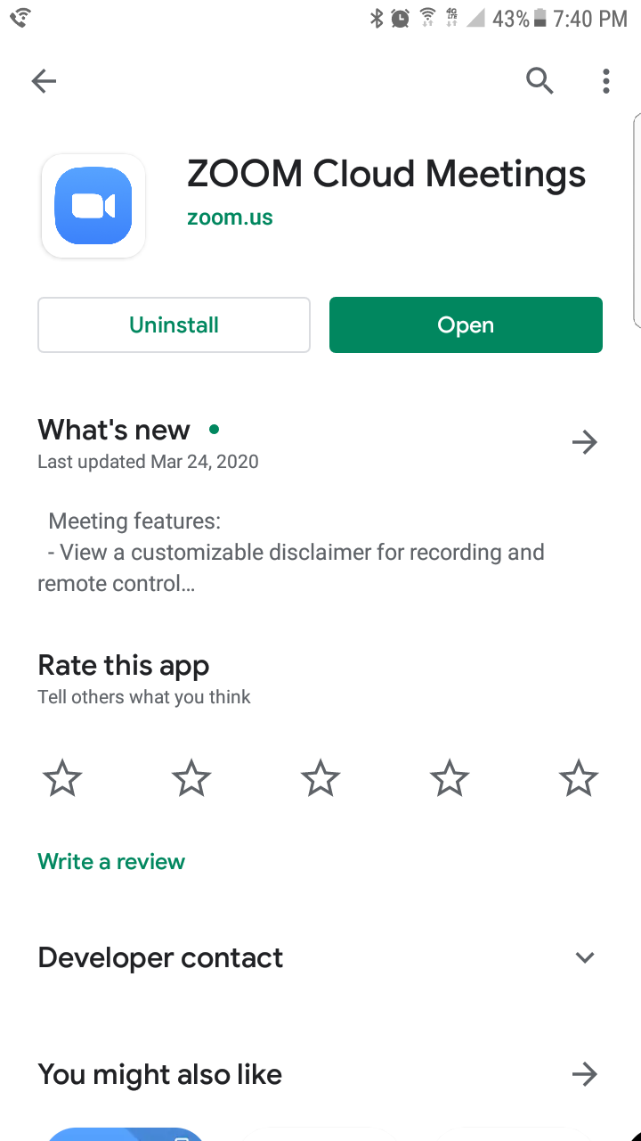
Get the Zoom App
You have to get the Zoom App for Android from the Play Store.

Slide 3
Zoom on Android
Once your Zoom App is in stalled, go to the invitation in your email.
When you open the invitation, click the link in the invitation to join the meeting:
Email version:
ZOOM Meeting information: Topic: Sunday Morning Worship Time: Mar 29, 2020 10:00 AM Eastern Time (US and Canada) Join Zoom Meeting https://bit.ly/2UrheK6 Meeting ID: 320 278 497 Dial in at 1 646 558 8656 US (New York) Meeting ID: 257 087 648

Slide 4
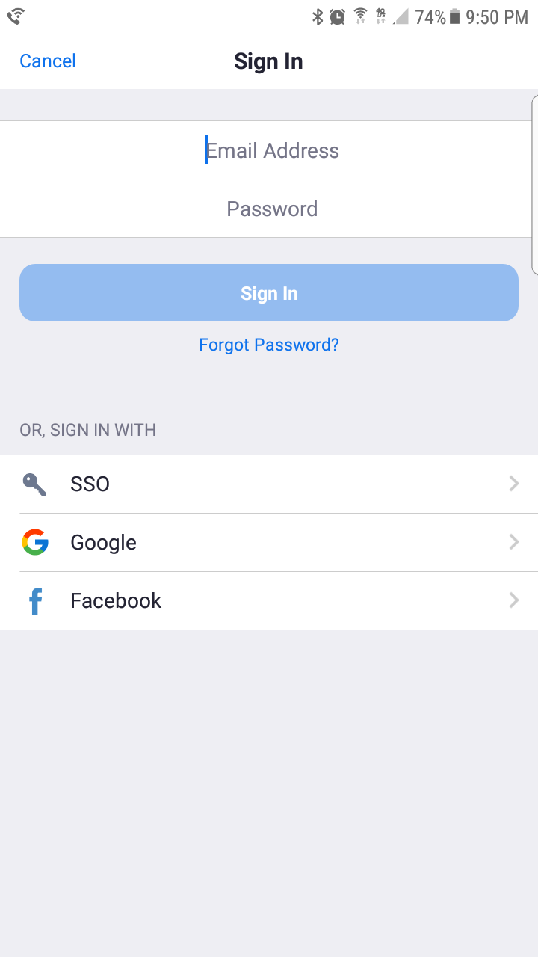
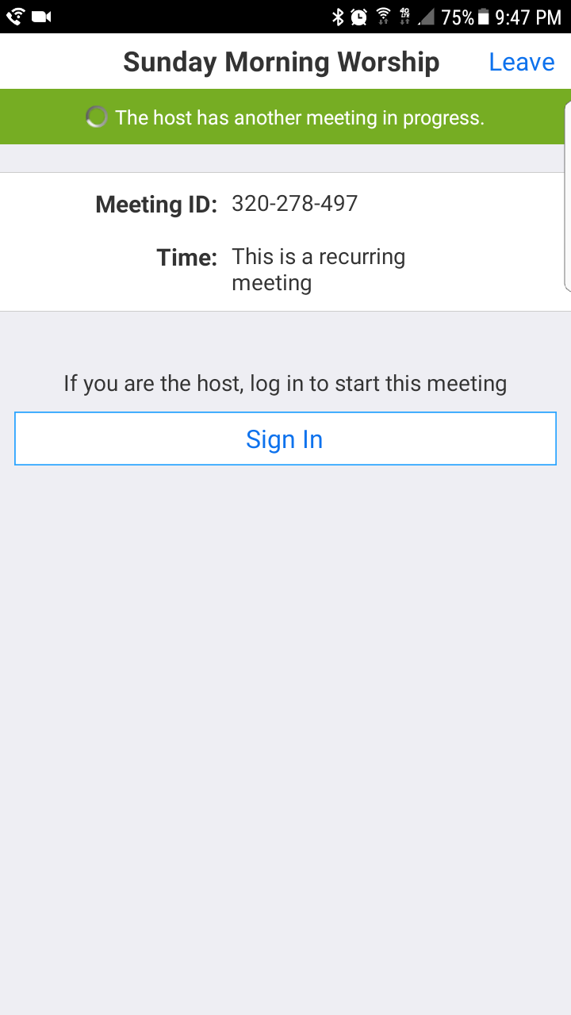
Signing in with Android

Slide 5
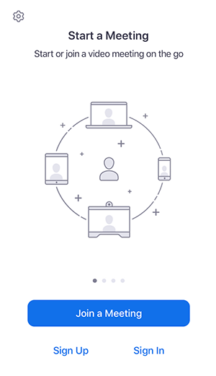
Sign in and Join the Meeting
Open the Zoom app and sign into your account to access all features.
You can also join a meeting without signing in. Tap the gear icon to access basic meeting settings if you join without signing in.
ZOOM ICON
GEAR ICON

Slide 6
Minimum Requirements
Supported Operating Systems
iOS 7.0 or later
Send and receive video using front or rear camera
iPhone 4 or later, iPad Pro, iPad Mini, iPad 2 or later, iPod touch 4th Generation, iPhone 3GS (no front facing camera)
iPadOS 13 or later
Android 4.0x or later
Kindle Fire HD
Supported Browsers for Web Start
iOS/iPadOS: Safari5+, Chrome
Android: Webkit (default), Chrome
Processor Requirement
Any 1 Ghz single core processor or better (non-Intel)

