Slide 1
Getting Started in Zoom with iOS (iPhone, iPad)

Slide 2
Zoom on iPhone and iPad
Go to the App Store
Look for ZOOM Cloud Meetings 4+
Zoom
Download the Zoom App
This app is available only on the App Store for iPhone and iPad.
It is Free!
This version requires iOS 8.0 or later

Slide 3
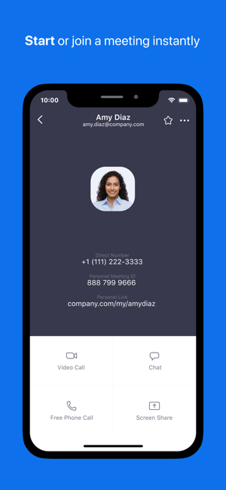
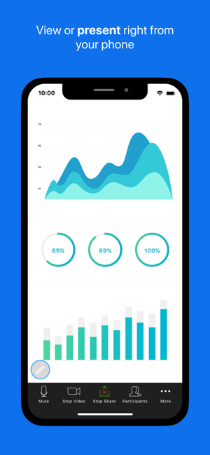
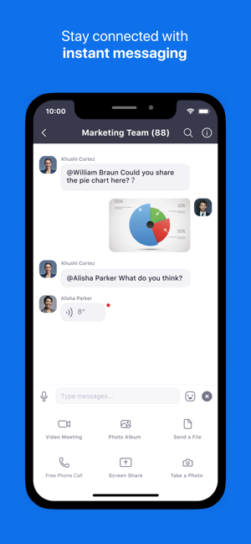
iPhone Screenshots

Slide 4
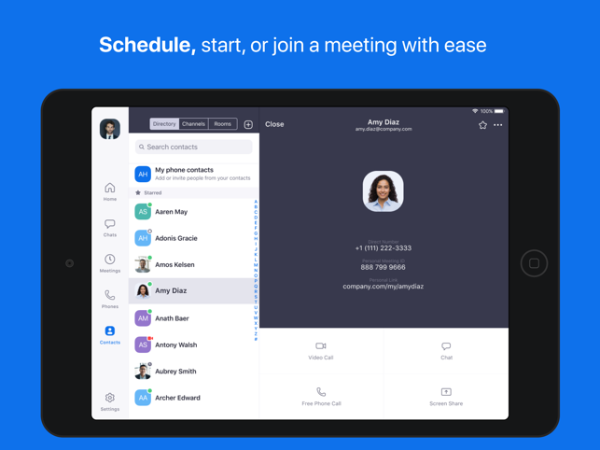
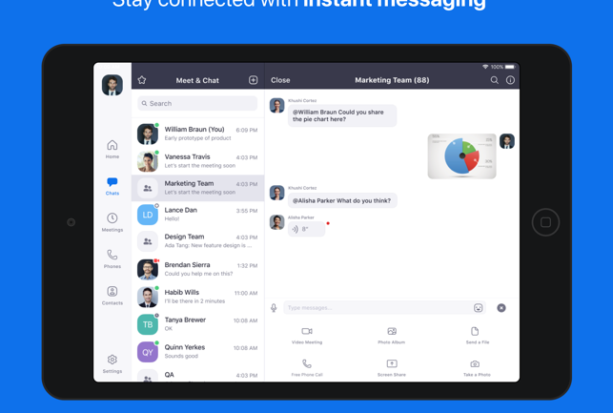
iPad Screenshots

Slide 5
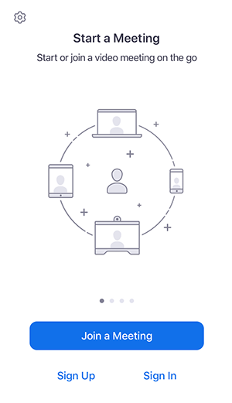
Sign in and Join the Meeting
Open the Zoom app and sign into your account to access all features.
You can also join a meeting without signing in. Tap the gear icon to access basic meeting settings if you join without signing in.

